Slide 1
MURANG’A UNIVERSITY OF TECHNOLOGY
CHAPTER THREE
SEMICONDUCTOR THEORY AND DEVICES
11.1 Band Theory of Solids
11.2 Semiconductor Theory
11.3 Semiconductor Devices
11.4 Nanotechnology
josephkamwere7@gmail.com

Slide 2
Band Theory of Solids
In this chapter we concentrate on electrical conduction.
josephkamwere7@gmail.com

Slide 3
Categories of Solids
There are three categories of solids, based on their conducting properties:
  conductors
  semiconductors
  insulators
josephkamwere7@gmail.com

Slide 4
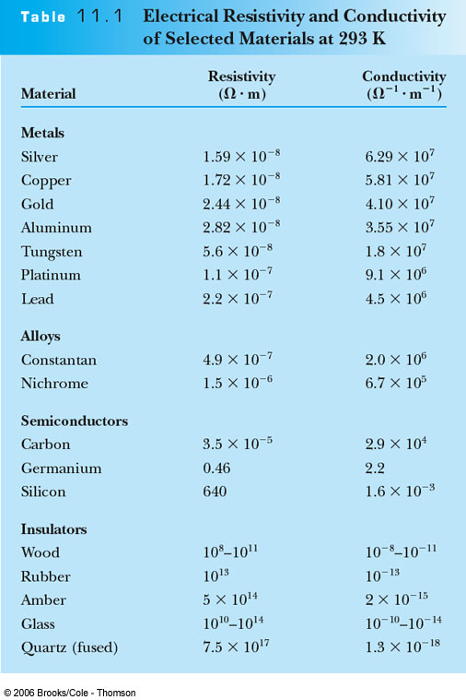
Electrical Resistivity and Conductivity of
Selected Materials at 293 K
0
josephkamwere7@gmail.com

Slide 5
Reviewing the previous table reveals that:
The electrical conductivity at room temperature is quite different for each of these three kinds of solids
  Metals and alloys -highest conductivities
  (10⁻⁷ to 10⁻⁸m ohms)
  Semiconductors - conducts partially
  (10⁻³to 10³m ohms)
  Insulators - do not conduct(poorest conductor)
(10⁴ to 10¹⁴m ohms)
josephkamwere7@gmail.com

Slide 6
Semiconductor Conduction
The free-electron model do not apply to semiconductors and insulators, since these materials simply lack free electrons to conduct in a free-electron mode, this is due to the nature of the bond in the crystal
There is a different conduction mechanism for semiconductors than for normal conductors.
In general over a range of temperature the resistance of a conductor increases with increase in temperature. The resistance of insulators remains constant in variation in temperature.
josephkamwere7@gmail.com

Slide 7
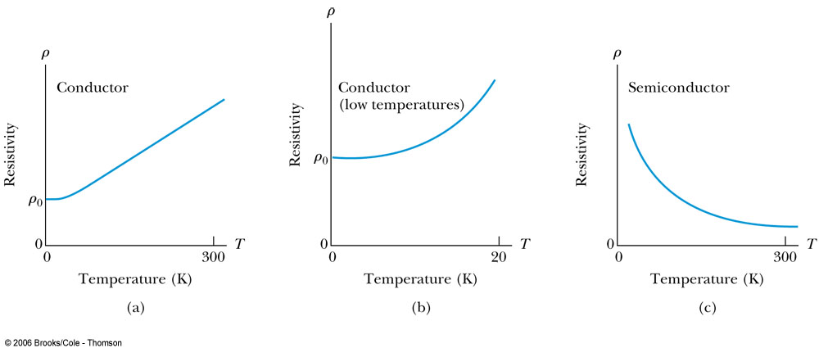
Resistivity vs. Temperature
(a) Resistivity versus temperature for a typical conductor. Notice the linear rise in resistivity with increasing temperature at all but very low temperatures. (b) Resistivity versus temperature for a typical conductor at very low temperatures. Notice that the curve flattens and approaches a nonzero resistance as T → 0. (c) Resistivity versus temperature for a typical semiconductor. The resistivity increases dramatically as T → 0.
josephkamwere7@gmail.com

Slide 8
Band Theory and Conductivity
Band theory helps us understand what makes a conductor, insulator, or semiconductor.
  Good conductors like copper can be understood using the free electron
  It is also possible to make a conductor using a material with its highest band filled, in which case no electron in that band can be considered free.
  (the outer most energy level is filled)
  If this filled band overlaps with the next higher band, however (so that effectively there is no gap between these two bands) then an applied electric field can make an electron from the filled band jump to the higher level.
This allows conduction to take place, although typically with slightly higher resistance than in normal metals. Such materials are known as semimetals.
josephkamwere7@gmail.com

Slide 9
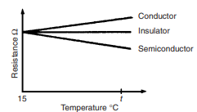
SILICON AND GERMANIUM
Most of the semiconductors used in the electronics industry are the silicon and germanium.(commonly used semiconductors)
Factors affecting conductors
Temparature
As the temperature is raised the resistivity is reduced ultimately to a point where it becomes effectively conducting.
For this reason
silicon should not operate to temperature at 150⁰c to 200⁰c depending on it purity.
Germanium should not work in a temperature
That is in excess of 75⁰c to 90⁰c
josephkamwere7@gmail.com

Slide 10
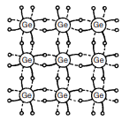
Holes and Intrinsic Semiconductors
When electrons move into the conduction band, they leave behind vacancies in the valence band. These vacancies are called holes. Because holes represent the absence of negative charges, it is useful to think of them as positive charges.
Whereas the electrons move in a direction opposite to the applied electric field, the holes move in the direction of the electric field.
A semiconductor in which there is a balance between the number of electrons in the conduction band and the number of holes in the valence band is called an intrinsic semiconductor.
Intrinsic semiconductors –these are pure semiconductors that has not been dopes with impurities
Examples of intrinsic semiconductors
include pure carbon and germanium.
( figure ) pure semiconductor
josephkamwere7@gmail.com

Slide 11
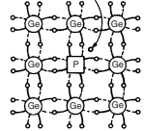
Impurity Semiconductor
It is possible to fine-tune a semiconductor’s properties by adding a small amount of another material, called a dopant, to the semiconductor creating what is a called an impurity semiconductor.
Extremely addition of small amount of impurities to pure semi-conductors is called Doping
As an example, silicon (pure semi-conductor) has four electrons in its outermost shell (this corresponds to the valence band) and arsenic has five (dopant ).
Thus while four of arsenic’s outer-shell electrons participate in covalent bonding with its nearest neighbors (just as another silicon atom would), the fifth electron is very weakly bound.
It takes only about 0.05 eV to move this extra electron into the conduction band.
(amount of energy required to shift it from semiconductor to conducting state)
The effect is that adding only a small
amount of arsenic to silicon greatly
increases the electrical conductivity.
( figure ) doped semiconductor
josephkamwere7@gmail.com

Slide 12
N-type Semiconductor (donor Levels)
arsenic, antimony and phosphorous are called n type impurities
The addition of arsenic, antimony and phosphorous to silicon or germanium creates what is known as an n-type semiconductor (n for negative), because it is the electrons close to the conduction band that will eventually carry electrical current.
The new arsenic energy levels just below the conduction band are called donor levels because an electron there is easily donated to the conduction band.
josephkamwere7@gmail.com

Slide 13
P-type Semiconductor (Acceptor Levels)
Consider what happens when indium aluminum are added to silicon or germanium semiconductors.
  Indium has one less electron in its outer shell than silicon. The result is one extra hole per indium atom. The existence of these holes creates extra energy levels just above the valence band, because it takes relatively little energy to move another electron into a hole
  Those new indium levels are called acceptor levels because they can easily accept an electron from the valence band. Again, the result is an increased flow of current (or, equivalently, lower electrical resistance) as the electrons move to fill holes under an applied electric field
It is always easier to think in terms of the flow of positive charges (holes) in the direction of the applied field, so we call this a p-type semiconductor (p for positive).
  acceptor levels p-Type semiconductors
In addition to intrinsic and impurity semiconductors, there are many compound semiconductors, which consist of equal numbers of two kinds of atoms.
josephkamwere7@gmail.com

Slide 14

Thermoelectric Effect
In one dimension the induced electric field E in a semiconductor is proportional to the temperature gradient, so that
where Q is called the thermoelectric power.
The direction of the induced field depends on whether the semiconductor is p-type or n-type, so the thermoelectric effect can be used to determine the extent to which n- or p-type carriers dominate in a complex system.
josephkamwere7@gmail.com

Slide 15
Thermoelectric Effect
When there is a temperature gradient in a thermoelectric material, an electric field appears.
  This happens in a pure metal since we can assume the system acts as a gas of free electrons.
  As in an ideal gas, the density of free electrons is greater at the colder end of the wire, and therefore the electrical potential should be higher at the warmer end and lower at the colder end.
  The free-electron model is not valid for semiconductors; nevertheless, the conducting properties of a semiconductor are temperature dependent, as we have seen, and therefore it is reasonable to believe that semiconductors should exhibit a thermoelectric effect.
This thermoelectric effect is sometimes called the Seebeck effect.
josephkamwere7@gmail.com

Slide 16
The Thomson and Peltier Effects
In a normal conductor, heat is generated at the rate of I²R. But a temperature gradient across the conductor causes additional heat to be generated.
This is the Thomson Effect.
Here heat is generated if current flows toward the higher temperature and absorbed if toward the lower.
The Peltier effect occurs when heat is generated at a junction between two conductors as current passes through the junction.
josephkamwere7@gmail.com

Slide 17
The Thermocouple
An important application of the Seebeck thermoelectric effect is in thermometry. The thermoelectric power of a given conductor varies as a function of temperature, and the variation can be quite different for two different conductors.
This difference makes possible the operation of a thermocouple.
josephkamwere7@gmail.com

Slide 18
11.3: Semiconductor Devices
pn-junction Diodes
Here p-type and n-type semiconductors are joined together.
The principal characteristic of a pn-junction diode is that it allows current to flow easily in one direction but hardly at all in the other direction.
We call these situations forward bias and reverse bias, respectively.
josephkamwere7@gmail.com

Slide 19
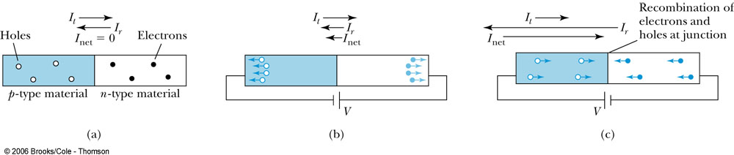
Operation of a pn-junction Diode
The operation of a pn-junction diode. (a) This is the no-bias case. The small thermal electron current (I_{t}) is offset by the electron recombination current (I_{r}). The net positive current (I_{net}) is zero. (b) With a DC voltage applied as shown, the diode is in reverse bias. Now I_{r} is slightly less than I_{t}. Thus there is a small net flow of electrons from p to n and positive current from n to p. (c) Here the diode is in forward bias. Because current can readily flow from p to n, I_{r} can be much greater than I_{t}. [Note: In each case, I_{t} and I_{r} are electron (negative) currents, but I_{net} indicates positive current.]
josephkamwere7@gmail.com

Slide 20

Semi conductor diodes
A semiconductor diode is a device having a p n junction mounted in a container.
Symbols
Forward bias. When the positive terminal of the power source is connected to the p type material and the negative terminal connected to the N-type of the material.
Due to the like charges the holes in the P-type material drifts towards the junction and similarly the N-type materials are repelled by the negative bias voltage and thus are drifted towards the junction.
About 0.6v is required to open the junction and shift the semiconductor to the conducting state
josephkamwere7@gmail.com

Slide 21
Semi conductor diodes
Reverse bias
When a negative terminal is connected to the P-type material and the positive terminal is connected to the N-type material it is called a reverse bias
Holes on the P-type materials are attracted to the negative terminal and the electrons on the N-type material are attracted to the positive terminal (unlike chares attract) the drift increases the junction ad only few majority charge carriers have the sufficient energy to surmount the junction.
Zenner effect- results from a sufficient voltage to break the covalent bond
Avalanches effect –results from the charge carriers moving at a sufficient speed to break the covalent bond through collision.
josephkamwere7@gmail.com

Slide 22
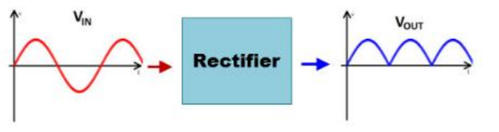
1 RECTIFIERS
Applications of a diode
A rectifier is an electrical device that converts AC supply into unidirectional DC supply.
Rectification-This process of converting alternating current (AC) to direct current (DC)
Types of rectifiers
Full wave rectifiers –bridge rectifier
- center tap rectifier
Half wave rectifiers
josephkamwere7@gmail.com

Slide 23
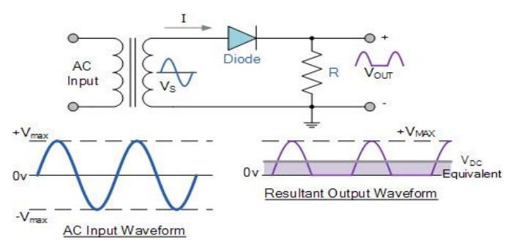
Half Wave Rectifier
It is a simple type of rectifier made with single diode which is connected in series with load.
josephkamwere7@gmail.com

Slide 24
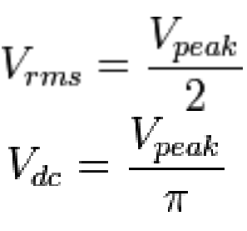
Half Wave Rectifier
During the positive half of the AC input, diode becomes forward biased and currents starts flowing through it.
During the negative half of the AC input, diode becomes reverse biased and current stops flowing through it
The output DC voltage of a half wave rectifier can be calculated with the following two ideal equations
The rectifier has an efficiency of 40.6%
josephkamwere7@gmail.com

Slide 25
Half Wave Rectifier
Advantage
Simple circuit and low cost
Disadvantage
The output current in the load contains, in addition to dc component, ac components of basic frequency equal to that of the input voltage frequency.
Ripple factor is high and an elaborate filtering is, therefore, required to give steady dc output.
The power output and, therefore, rectification efficiency is quite low. This is due to the fact that power is delivered only half the time.
Transformer Utilization Factor (TUF) is low.
DC saturation of transformer core resulting in magnetizing current and hysteresis losses and generation of harmonics
josephkamwere7@gmail.com

Slide 26
Full Wave Center-tapped Rectifier
This type of rectifier uses two diodes and a transformer with center tapped secondary winding.
During the positive half cycle of the input AC diode D1 is forward biased and the current starts flowing to the load through it.
During the negative half of the input diode D2 forward biased and D1 becomes reverse biased.
Load current start flowing through D2 during this negative peak.
Note that the current flow through load has not changed even when the voltage polarity changed
josephkamwere7@gmail.com

Slide 27
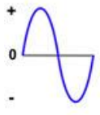
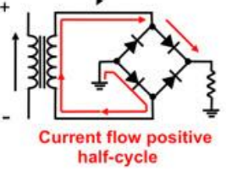
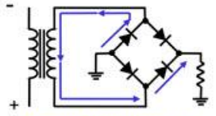
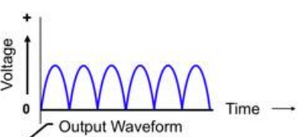
Bridge Rectifiers
Using the same secondary voltage, this bridge rectifier can produce almost double the output voltage as compared with full wave center-tapped transformer rectifier.
During the positive half of the input AC diodes D1 and D2 are forward biased and D3 and D4 are reverse biased. Thus load current flows through D1 and D2 diodes.
During the negative half cycle of the input diodes D3&D4 are forward biased and D1&D2 are reverse biased.
Therefore load current flows through D3&D4 diodes.
josephkamwere7@gmail.com

Slide 28
Bridge Rectifiers
Advantages of bridge rectifier
The rectification efficiency of full-wave rectifier is double of that of a half-wave rectifier.
Higher output voltage, higher output power and higher Transformer Utilization Factor in case of full wave rectifier.
The ripple voltage is low and of higher frequency in case of full-wave rectifier so simple filtering circuit is required
No center tap is required in the transformer secondary so in case of a bridge rectifier the transformer required is simpler
If stepping up or stepping down of voltage is not required, transformer can be eliminated even.
For a given power output, power transformer of smaller size can be used in case of the bridge rectifier because current in both primary and secondary windings of the supply transformer flow for the entire ac cycle
josephkamwere7@gmail.com

Slide 29
Bridge Rectifiers
Disadvantages of Bridge Rectifier
It requires four diodes.
The use of two extra diodes cause an additional voltage drop thereby reducing the output voltage.
josephkamwere7@gmail.com

Slide 30
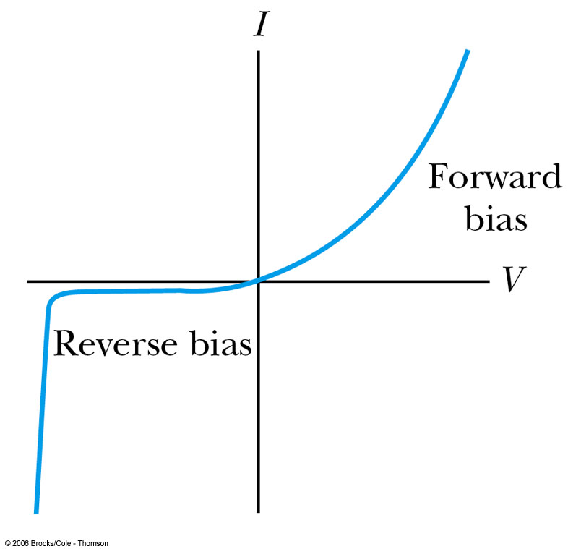
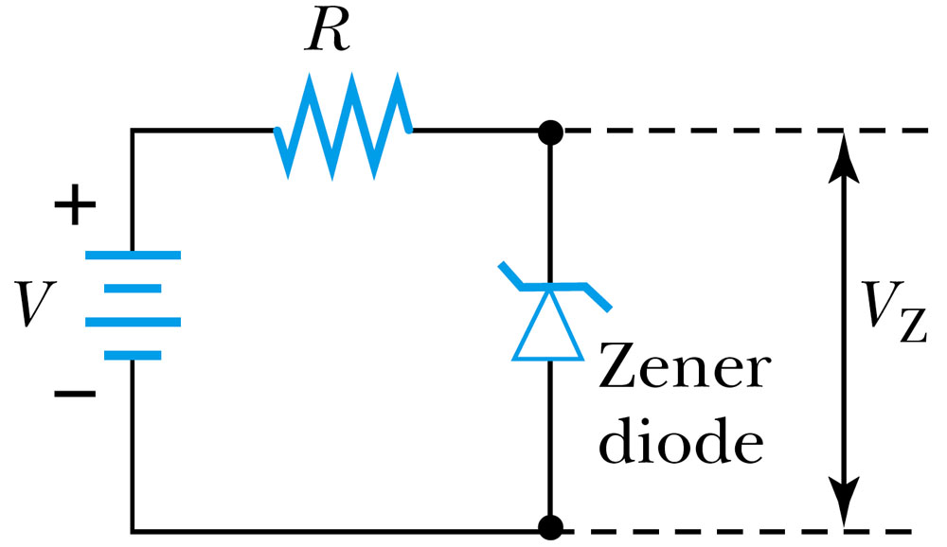
Zener Diodes
The Zener diode is made to operate under reverse bias once a sufficiently high voltage has been reached. The I-V curve of a Zener diode is shown in Figure 11.15. Notice that under reverse bias and low voltage the current assumes a low negative value, just as in a normal pn-junction diode. But when a sufficiently large reverse bias voltage is reached, the current increases at a very high rate.
Figure 11.15: A typical I-V curve for a Zener diode.
Figure 11.16: A Zener diode reference circuit.
josephkamwere7@gmail.com

Slide 31
TYPES OF DIODES AND THEIR CHARACTERISTICS
Zener diodes
Light emitting diodes
Photo voltaic cell
Schottky diodes
josephkamwere7@gmail.com

Slide 32
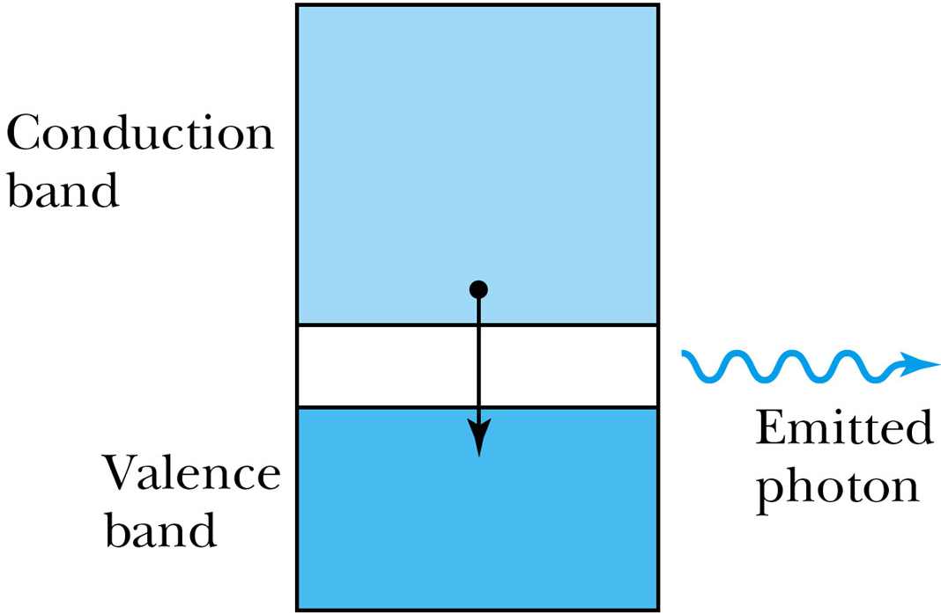
Light Emitting Diodes
Another important kind of diode is the light-emitting diode (LED).
Whenever an electron makes a transition from the conduction band to the valence band (effectively recombining the electron and hole) there is a release of energy in the form of a photon
In some materials the energy levels are spaced so that the photon is in the visible part of the spectrum. In that case, the continuous flow of current through the LED results in a continuous stream of nearly monochromatic light.
Figure 11.17: Schematic of an LED. A photon is released as an electron falls from the conduction band to the valence band. The band gap may be large enough that the photon will be in the visible portion of the spectrum.
josephkamwere7@gmail.com

Slide 33
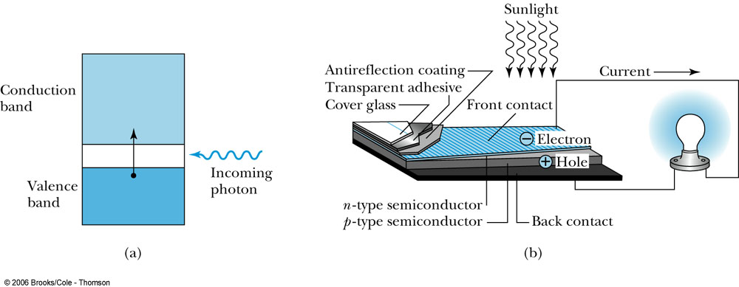
Photovoltaic Cells
A solar cell takes incoming light energy and turns it into electrical energy.
A good way to think of the solar cell is to consider the LED in reverse.
A pn-junction diode can absorb a photon of solar radiation by having an electron make a transition from the valence band to the conduction band.
In doing so, both a conducting electron and a hole have been created. If a circuit is connected to the pn junction, the holes and electrons will move so as to create an electric current, with positive current flowing from the p side to the n side. Even though the efficiency of most solar cells is low, their widespread use could potentially generate significant amounts of electricity. Remember that the “solar constant” (the energy per unit area of solar radiation reaching the Earth) is over 1400 W/m², and more than half of this makes it through the atmosphere to the Earth’s surface. There has been tremendous progress in recent years toward making solar cells more efficient.
josephkamwere7@gmail.com

Slide 34
TRANSISTORS
josephkamwere7@gmail.com

Slide 35
Transistors
Transistors are made up of P-N diodes connected
josephkamwere7@gmail.com

Slide 36
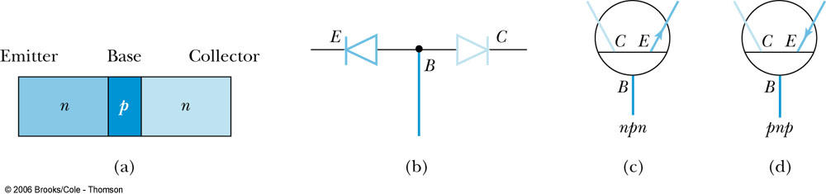
Transistors
Another use of semiconductor technology is in the fabrication of transistors, devices that amplify voltages or currents in many kinds of circuits. The first transistor was developed in 1948 by John Bardeen, William Shockley, and Walter Brattain. As an example we consider an N-P-N junction transistor, which consists of a thin layer of P-type semiconductor sandwiched between two n-type semiconductors. The three terminals (one on each semiconducting material) are known as the collector, emitter, and base. A good way of thinking of the operation of the npn-junction transistor is to think of two pn-junction diodes back to back.
josephkamwere7@gmail.com

Slide 37
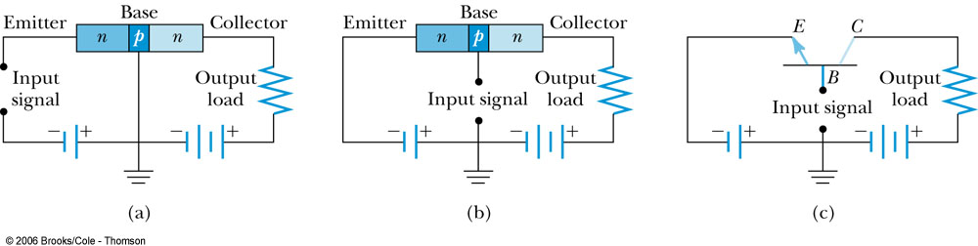
Transistors
Consider now the npn junction in the circuit shown in Figure 11.23a. If the emitter is more heavily doped than the base, then there is a heavy flow of electrons from left to right into the base. The base is made thin enough so that virtually all of those electrons can pass through the collector and into the output portion of the circuit. As a result the output current is a very high fraction of the input current. The key now is to look at the input and output voltages. Because the base-collector combination is essentially a diode connected in reverse bias, the voltage on the output side can be made higher than the voltage on the input side. Recall that the output and input currents are comparable, so the resulting output power (current × voltage) is much higher than the input power.
Figure 11.23: (a) The npn transistor in a voltage amplifier circuit. (b) The circuit has been modified to put the input between base and ground, thus making a current amplifier. (c) The same circuit as in (b) using the transistor circuit symbol.
josephkamwere7@gmail.com

Slide 38
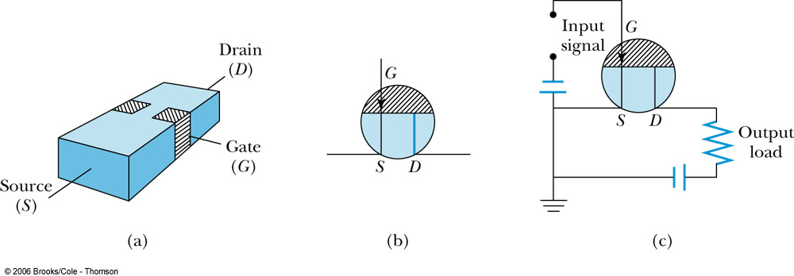
Field Effect Transistors (FET)
The three terminals of the FET are known as the drain, source, and gate, and these correspond to the collector, emitter, and base, respectively, of a bipolar transistor.
Figure 11.25: (a) A schematic of a FET. The two gate regions are connected internally. (b) The circuit symbol for the FET, assuming the source-to-drain channel is of n-type material and the gate is p-type. If the channel is p-type and the gate n-type, then the arrow is reversed. (c) An amplifier circuit containing a FET.
josephkamwere7@gmail.com

Slide 39
Schottky Barriers
Here a direct contact is made between a metal and a semiconductor. If the semiconductor is n-type, electrons from it tend to migrate into the metal, leaving a depleted region within the semiconductor.
This will happen as long as the work function of the metal is higher (or lower, in the case of a p-type semiconductor) than that of the semiconductor.
The width of the depleted region depends on the properties of the particular metal and semiconductor being used, but it is typically on the order of microns. The I-V characteristics of the Schottky barrier are similar to those of the pn-junction diode. When a p-type semiconductor is used, the behavior is similar but the depletion region has a deficit of holes.
josephkamwere7@gmail.com

Slide 40
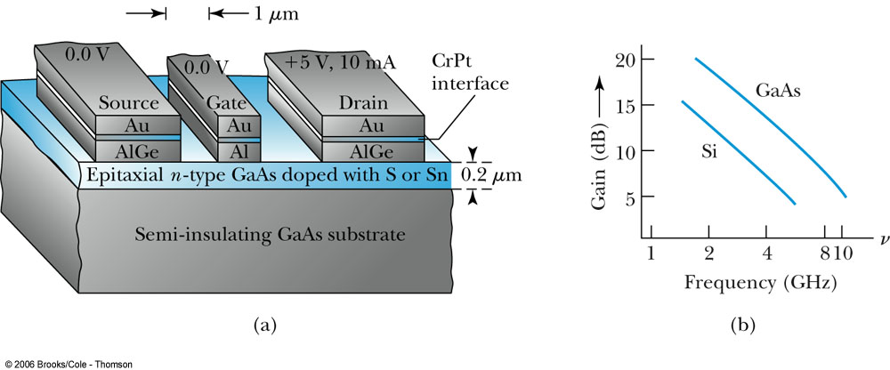
Schottky Barriers
Figure 11.26: (a) Schematic drawing of a typical Schottky-barrier FET. (b) Gain versus frequency for two different substrate materials, Si and GaAs. From D. A. Fraser, Physics of Semiconductor Devices, Oxford: Clarendon Press (1979).
josephkamwere7@gmail.com

Slide 41
Semiconductor Lasers
Like the gas lasers described in Section 10.2, semiconductor lasers operate using population inversion—an artificially high number of electrons in excited states
In a semiconductor laser, the band gap determines the energy difference between the excited state and the ground state
Semiconductor lasers use injection pumping, where a large forward current is passed through a diode creating electron-hole pairs, with electrons in the conduction band and holes in the valence band.
A photon is emitted when an electron falls back to the valence band to recombine with the hole.
josephkamwere7@gmail.com

Slide 42
Semiconductor Lasers
Since their development, semiconductor lasers have been used in a number of applications, most notably in fiber-optics communication.
One advantage of using semiconductor lasers in this application is their small size with dimensions typically on the order of 10⁻⁴ m.
Being solid-state devices, they are more robust than gas-filled tubes.
josephkamwere7@gmail.com

Slide 43
Integrated Circuits
The most important use of all these semiconductor devices today is not in discrete components, but rather in integrated circuits called chips.
Some integrated circuits contain a million or more components such as resistors, capacitors, and transistors.
Two benefits: miniaturization and processing speed.
josephkamwere7@gmail.com

Slide 44
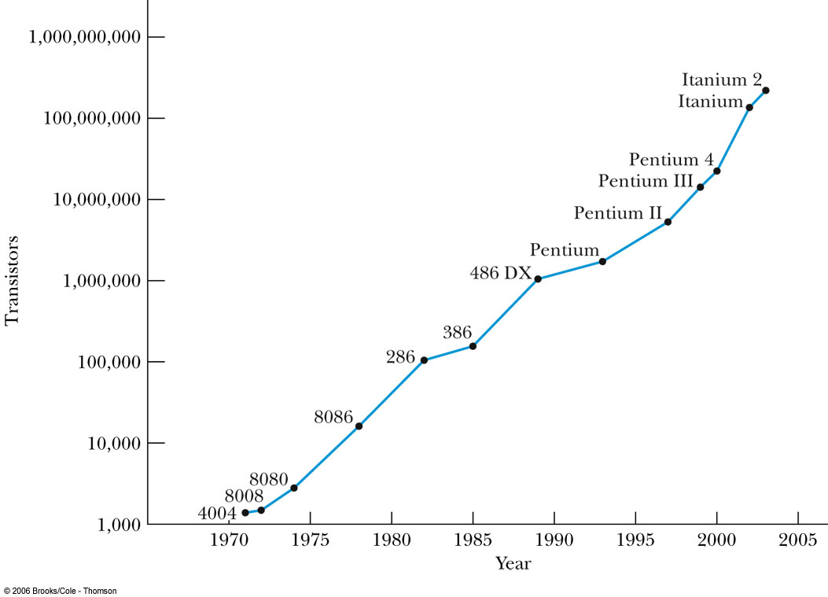
Moore’s Law and Computing Power
Figure 11.29: Moore’s law, showing the progress in computing power over a 30-year span, illustrated here with Intel chip names. The Pentium 4 contains over 50 million transistors. Courtesy of Intel Corporation. Graph from http://www.intel.com/research/silicon/mooreslaw.htm.
josephkamwere7@gmail.com

Slide 45
11.4: Nanotechnology
Nanotechnology is generally defined as the scientific study and manufacture of materials on a submicron scale.
These scales range from single atoms (on the order of .1 nm up to 1 micron (1000 nm).
This technology has applications in engineering, chemistry, and the life sciences and, as such, is interdisciplinary.
josephkamwere7@gmail.com

Slide 46
Carbon Nanotubes
In 1991, following the discovery of C60 buckminsterfullerenes, or “buckyballs,” Japanese physicist Sumio Iijima discovered a new geometric arrangement of pure carbon into large molecules.
In this arrangement, known as a carbon nanotube, hexagonal arrays of carbon atoms lie along a cylindrical tube instead of a spherical ball.
josephkamwere7@gmail.com

Slide 47
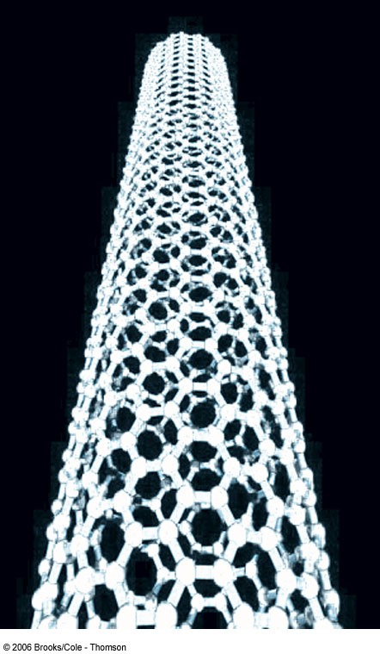
Structure of a Carbon Nanotube
Figure 11.30: Model of a carbon nanotube, illustrating the hexagonal carbon pattern superimposed on a tubelike structure. There is virtually no limit to the length of the tube. From http://www.hpc.susx.ac.uk/
~ewels/img/science/nanotubes/.
josephkamwere7@gmail.com

Slide 48
Carbon Nanotubes
The basic structure shown in Figure 11.30 leads to two types of nanotubes. A single-walled nanotube has just the single shell of hexagons as shown.
In a multi-walled nanotube, multiple layers are nested like the rings in a tree trunk.
Single-walled nanotubes tend to have fewer defects, and they are therefore stronger structurally but they are also more expensive and difficult to make.
josephkamwere7@gmail.com

Slide 49
Applications of Nanotubes
By their strength they are used as structural reinforcements in the manufacture of composite materials
  (batteries in cell-phones use nanotubes in this way)
Nanotubes have very high electrical and thermal conductivities, and as such lead to high current densities in high-temperature superconductors.
josephkamwere7@gmail.com

Slide 50
Nanoscale Electronics
One problem in the development of truly small-scale electronic devices is that the connecting wires in any circuit need to be as small as possible, so that they do not overwhelm the nanoscale components they connect.
In addition to the nanotubes already described, semiconductor wires (for example indium phosphide) have been fabricated with diameters as small as 5 nm.
josephkamwere7@gmail.com

Slide 51
Nanoscale Electronics
These nanowires have been shown useful in connecting nanoscale transistors and memory circuits.
These are referred to as nanotransistors.
josephkamwere7@gmail.com

Slide 52
Nanotechnology and the Life Sciences
The complex molecules needed for the variety of life on Earth are themselves examples of nanoscale design.
Examples of unusual materials designed for specific purposes include the molecules that make up claws, feathers, and even tooth enamel.
josephkamwere7@gmail.com

Slide 53
Information Science
It’s possible that current photolithographic techniques for making computer chips could be extended into the hard-UV or soft x-ray range, with wavelengths on the order of 1 nm, to fabricate silicon-based chips on that scale.
Possible quantum effects as devices become smaller, specifically the superposition of quantum states possibly leading to quantum computing.
josephkamwere7@gmail.com

Slide 54
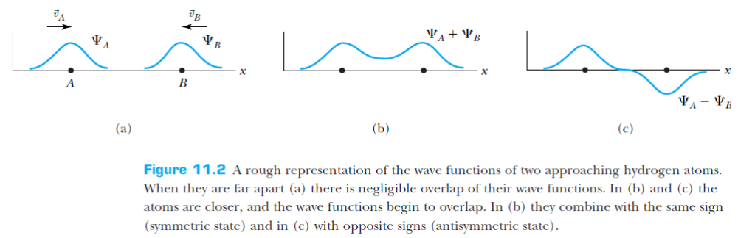
josephkamwere7@gmail.com

